Slide 1
Me on the Map

Slide 2
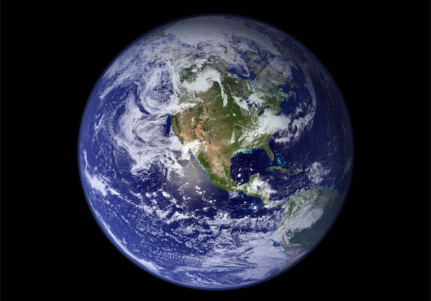
My Planet
We live in planet Earth

Slide 3
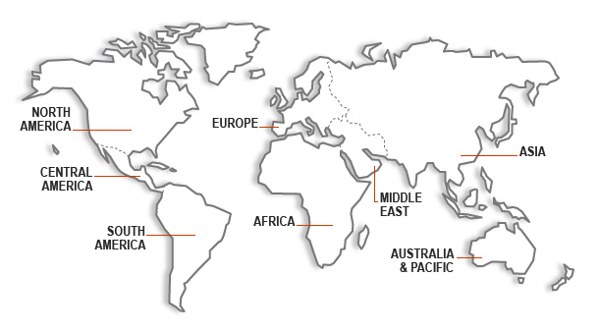
My Continent
Then, to find our continent we look at a world map. Our continent is North America

Slide 4
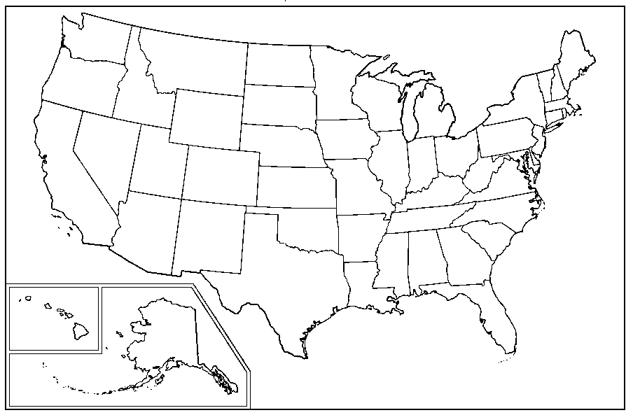
My Country
Next, we look at a map to find our country:
The United States of America

Slide 5
My State
Then, we look at the map of our country (USA) to find our state: Nevada

Slide 6
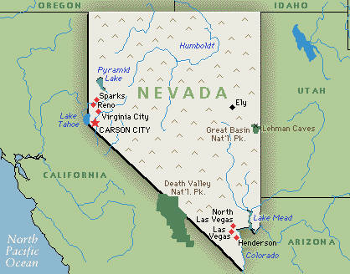
My City
Next, we look at our state map to find our city: Las Vegas or Henderson

Slide 7
My City
The city is the place that we live in

Slide 8
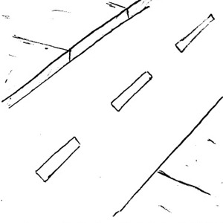
My Street
On the city map you find your street that tells you where your house is

Slide 9
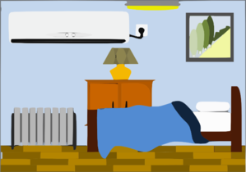
My house
In your house, you find your room. That is where we will find you!

